Slide 1
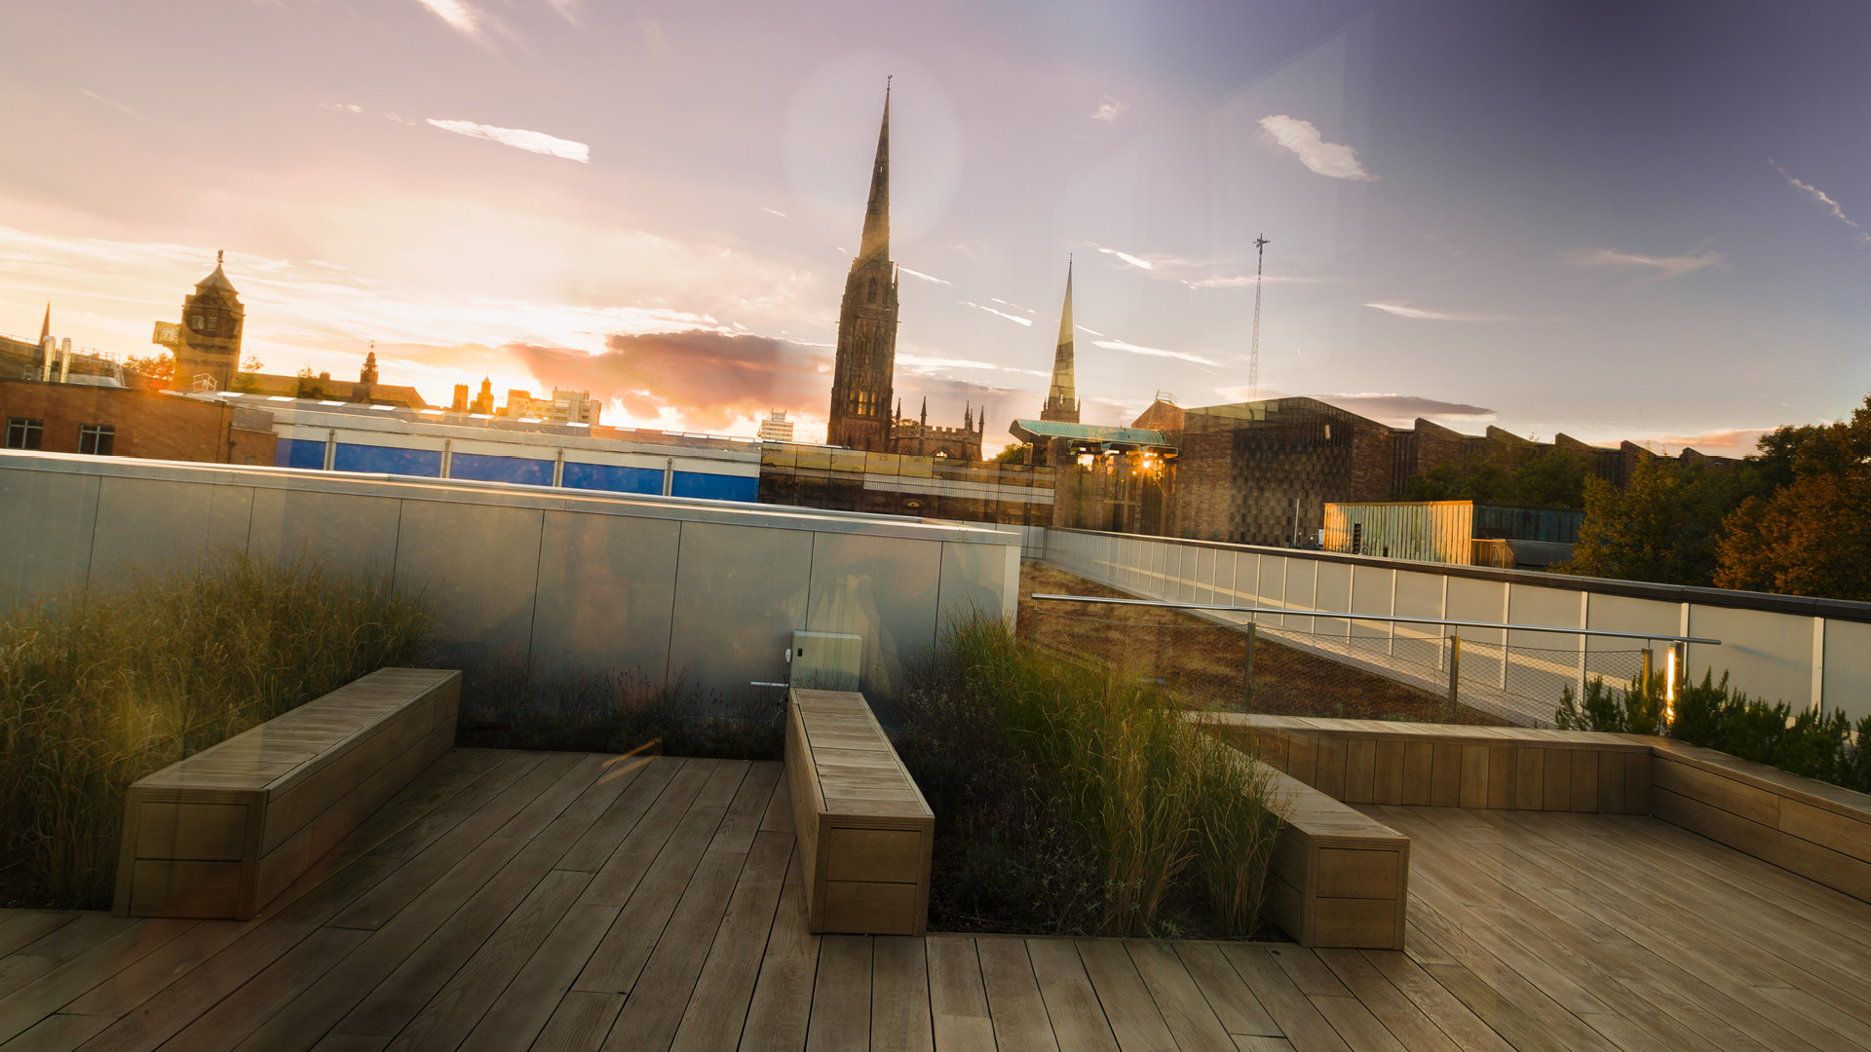


Group Projects – Individual Viva
Presented by Tsvetomir Pashov 7120158

Slide 2
Mandatory Question
What would you do differently, with hindsight, if you could do your project again?
Notes:
I would spend less time on the development of the base of the project which is the simple channel generation because this step has taken significant amount of time and it can be recorded using the macro record option inside catia.
I would also spend more time on finding how to design a conformal method for creating the channels. The reason for that is that this is the most innovative part of the project and it is the most important objective.

Slide 3
Optional Question 1
What have you learnt from this experience?
Notes:
What I have learnt is that creating the base of the project (e. g. channel generation) is important but spending too much time on it leads to having other sections fall back.
It has made me realise that the additional sections or methods shouldn’t just be pushed aside and left for the last moment where their development will inevitable be incomplete.
I have also learnt that breaking down tasks and doing background research on them before doing the actual work is critical for create appropriate solution.

Slide 4
Optional Question 2
What do you see as the next steps to take this project further?
Notes:
As stated previously the project is missing the conformal cooling method that will significantly push the application of the project.
Additionally, the project and more specifically the assembly function can be written in python using the pycatia library. This will support the future usage of the application for users that don’t use catia, are not professional in it or don’t have access to it.
Where Pycatia is a free to access and use library in python and can be used on any device regardless of its computational power.

Slide 5

The End

